Slide 1

AirFinance

Slide 2

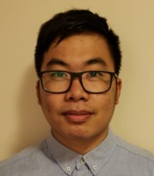


INTRODUCTION
MEET TEAM 23
[Replace with photo]
[Replace with photo]
[Replace with photo]
Jody Jin
Project Control Officer (Business)
Andrew Koung
Automation Engineer
(Developer)
Katherine Chen
Planning Coordinator (Business & Designer)
Emily Shao
Developer
(Developer)

Slide 3
EXECUTIVE SUMMARY

Slide 4

PROBLEM STATEMENT
PROBLEM + RESEARCH INSIGHTS
PROBLEM STATEMENT
How might we better engage and build meaningful/lasting relationships with international students during their time in Canada?
KEY QUESTION
International students are unaware of resources offered to help them manage their finances
Notes:
International students already have to pay triple the cost of domestic tuition, and many of them are living away from home for the first time. These students are typically unaware of resources that can help them track their finances, whether it is a mobile application that tracks finances or job opportunities to generate income, among others.

Slide 5

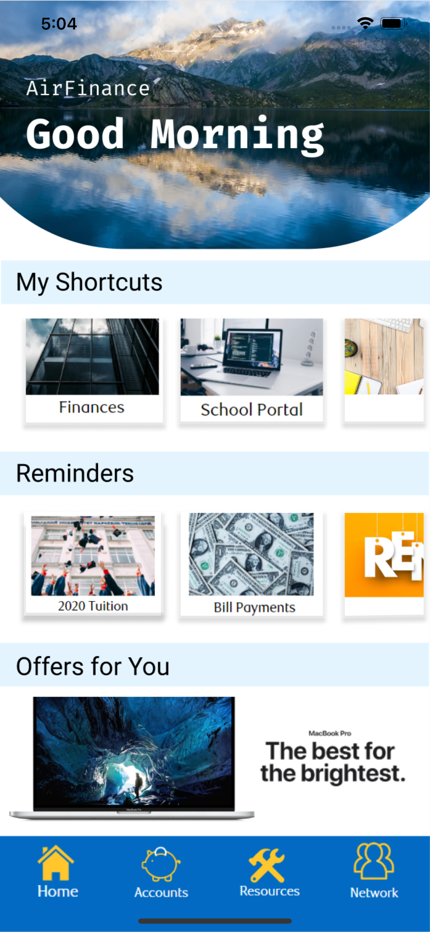



OUR SOLUTION
Notes:
Our solution is to give resources to students through a mobile application, AirFinance. Through AirFinance, students are given a wealth of resources that provide information, convenience, and financial aid.

Slide 6


SOLUTION SUMMARY
SOLUTION OVERVIEW
DESCRIPTION: A mobile app that offers services including
JAKE-TRON | Budget Tracker | News Article Linking
 | $70.00/$150.00 $92.76/$300.00 $183.40/$480
Don’t forget to pay your Winter 2020 Tuition!
Notes:
We understand how international students may have more financial hurdles than domestic students, and we want to offer these students the support they need.
Our product is a mobile application that offers various services. These include a chatbot named Jake who will answer questions and give reminders. Having a chatbot makes the app more customizable to students. It also enables students to interact conversationally and quickly with app to learn further about their finances and the resources provided to them.
Furthermore, the app includes a Budget Overview in transportation, shopping, or dining for example. This ensures the students are on track with their spending habits. The relationship between their expenses and budget is reflected on a live updating bar graph.
Another feature is the News Article Linking. It provides users with easy access to credible news articles related to tuition, schooling, financial aid, and other topics that may relate to them. This way, they are aware of news both in Canada and in their home country to better prepare for finances or other unexpected situations.

Slide 7
SOLUTION SUMMARY
BUSINESS VALUE
Greater… Client Acquisition
Greater… Efficiency
Greater… Revenue Generation
Notes:
AirFinance is an all-in-one mobile app that will bring more clients, greater efficiency, and more revenue.
To begin, customers prefer to have all resources in one place rather than many portals to search through. By having one spot with resources to help users balance their school work and financial management, we can attract more clients.
This will also be more efficient for RBC because it allows the users to keep track of their own finances, instead of RBC employees. For example, a user can consult a RBC employee on their spending less often by using the Budget Tracker in AirFinance, while the employee can help with other more pressing or human-centred tasks.
Finally, since AirFinance adopts a freemium-membership hybrid business model, RBC can earn revenue simply from implementing the app. The app will be free but there will be some desirable add-on features for a subscription fee. These include e-transfer tabs to keep track of spending between friends, and earning twice the normal amount of travel points per dollar spent.

Slide 8
SOLUTION SUMMARY
OPPORTUNITY
250 000
international student enrolments in 2016/17
11% increase
in enrolments from 2016/17 to 2017/18
Notes:
According to StatsCanada, over 250 thousand international students enrolled in Canadian postsecondary institutions during the 2016/17 school year. That means our target market is increased by 11% within the past year.
Statistics Canada

Slide 9
SOLUTION SUMMARY
OPPORTUNITY
“The fact is prices are different in Canada than they are in the Philippines and so is the value of money and I had to learn that.”
Stephanie Robinson
(international student from the Philippines)
Notes:
As stated in an article by the Canadian Immigrant, international students have different expectations of the value of money in Canada in comparison to their home country. Many students would like the opportunity to have more resources, but they are unsure where to find them.
Canadian Immigrant

Slide 10
SOLUTION SUMMARY
Why RBC?
Biggest bank in Canada
Most extensive combined ATM and branch network
Multiple bundles for newcomer students
Mission alignment
Notes:
RBC is the biggest bank in Canada, with the most employees to support their customers. International students also prefer to have extensive ATM access, and RBC has the most widespread network in Canada. Moreover, RBC has the RBC No Limit Banking for Students and RBC Student Banking bundles for newcomer students. To add, RBC’s value proposition states that they believe that “careful planning, … and consistent communication, [will ensure] clients … maintain financial peace of mind”. For international students, being able to maintain a peace of mind over their finances is crucial – they are also struggling to balance their schoolwork and adjust to being away from home. All in all, RBC has the biggest network and resources to support international students of the Big Five Canadian banks.
Student Life Network
Immigroup
RBC Wealth Management

Slide 11
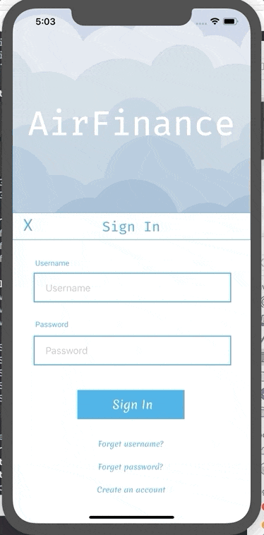

PROTOTYPE
MOBILE SCREEN
Sign in Screen
(Authentication)
Notes:
This is the home page, the first of three pages in the app. My Shortcuts, Reminders, and Offers for You are likely the most important elements of the app, which is why they are on the homepage when the user first clicks in to the app.
The Shortcuts section is customizable to each user, and this prototype illustrates the Finances and the School Portal. In Finances, the user can monitor their chequing and saving accounts, their budget tracking, and their cash inflows and outflows. The School Portal illustrates the price of room and board, academic materials, and lab equipment among others – any expenses of revenue relating to education. This section shows the big picture to the user, as some of these expenses need to be prepared for months in advance.
The Reminders section details payments that are due up to a month in advance. For example, tuition is a significant expense which occurs every four months, and rent is due monthly. If a friend owes the user money or vice versa, the Reminders section will also list it.
International students may be unfamiliar with deals in the area, or offers for students studying outside their home country. Electronic devices or other offers appear here.

Slide 12
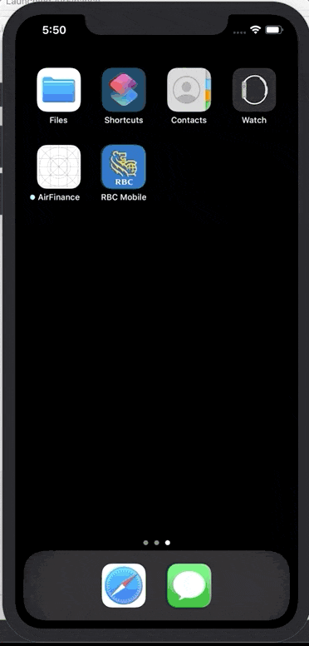

PROTOTYPE
MOBILE SCREEN Home Screen
(Overall app flow)
Notes:
This is the home page, the first of three pages in the app. My Shortcuts, Reminders, and Offers for You are likely the most important elements of the app, which is why they are on the homepage when the user first clicks in to the app.
The Shortcuts section is customizable to each user, and this prototype illustrates the Finances and the School Portal. In Finances, the user can monitor their chequing and saving accounts, their budget tracking, and their cash inflows and outflows. The School Portal illustrates the price of room and board, academic materials, and lab equipment among others – any expenses of revenue relating to education. This section shows the big picture to the user, as some of these expenses need to be prepared for months in advance.
The Reminders section details payments that are due up to a month in advance. For example, tuition is a significant expense which occurs every four months, and rent is due monthly. If a friend owes the user money or vice versa, the Reminders section will also list it.
International students may be unfamiliar with deals in the area, or offers for students studying outside their home country. Electronic devices or other offers appear here.

Slide 13
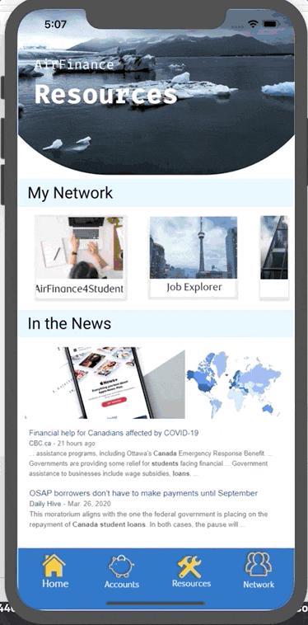
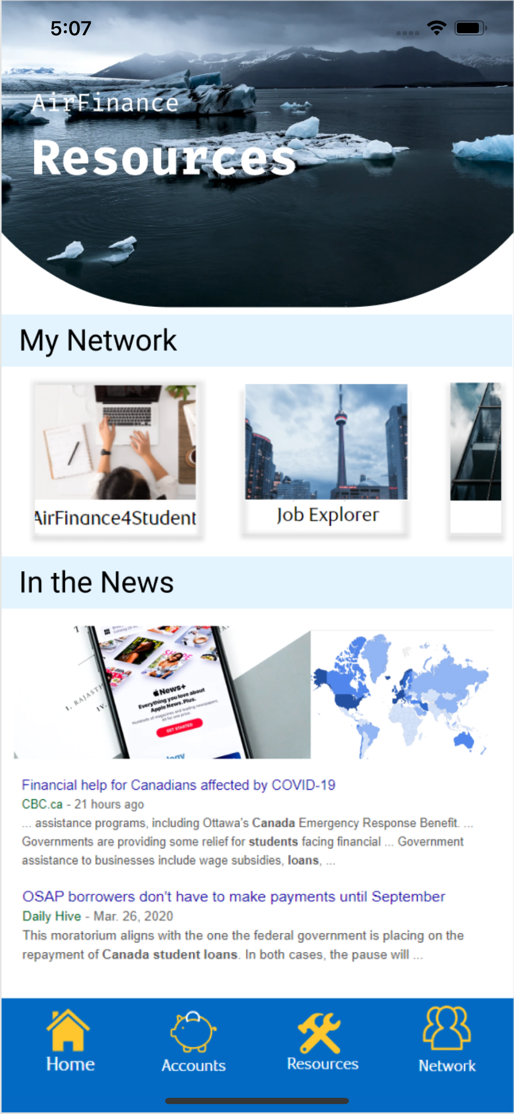

PROTOTYPE
MOBILE SCREEN
Resources
(Article Linking)
Notes:
The second page of AirFinance is the Resources page. As mentioned earlier, some international students are now in a completely foreign environment and may struggle to adapt. The Network and News sections help keep students informed.
AirFinance encourages its many users to build a community. Users are able to share information, study together, and build friendships. Many users would like to work part-time to cover their expenses, and AirFinance offers a Job Explorer portal to help out.
International students should regularly monitor the news in Canada and in their home country. Exchange rates and OSAP may help or hurt each user’s finances – it is important for the students to stay up to date. Another current example is COVID-19, since Canada is now under lockdown and the international students must decide whether to stay at school or travel home.

Slide 14
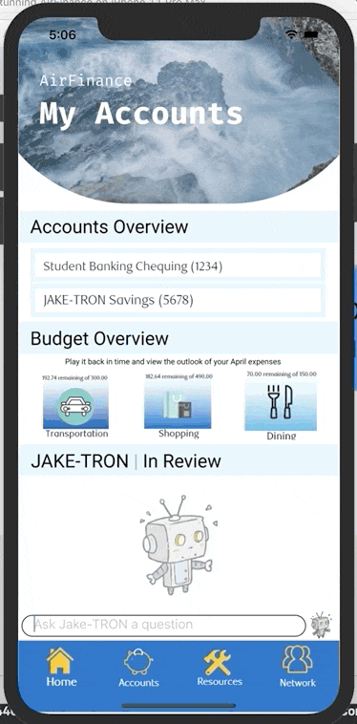
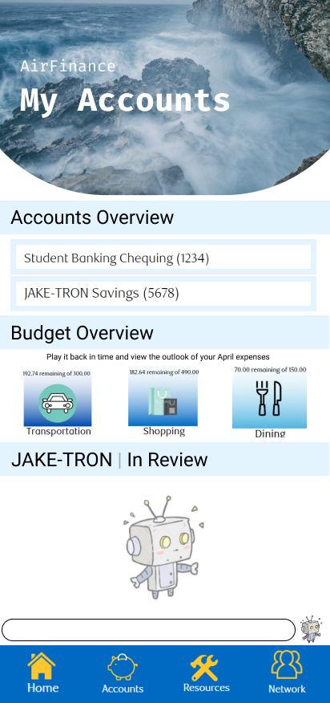
PROTOTYPE
MOBILE SCREEN
Accounts Overview
(AI Chatbot – JAKE)
Notes:
Finally, the user can check their Savings and Chequing Accounts through the My Accounts Page. The user can check their budget at a glance, and can also message Jake for questions and reminders.

Slide 15
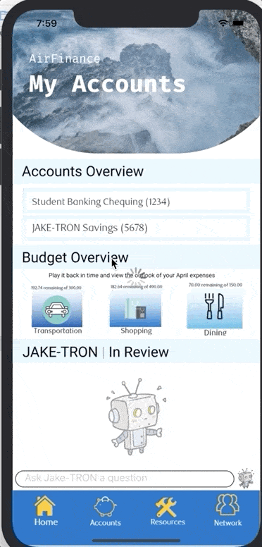
PROTOTYPE
MOBILE SCREEN
Budget Overview
Notes:
Users have the option to enter their financials into a budget overview. AirFinance tracks the cash inflows and outflows of each section, such as Transportation, Shopping, and Dining. A bar chart is shown to add expenses, or edit the budget.

Slide 16
STRATEGIC INSIGHTS

Slide 17



STRATEGIC INSIGHTS
COMPETITIVE LANDSCAPE
Mint (Advice) | You Need a Budget (Budget) | Wally (Expense Tracking)
Notes:
Our competitors are Mint, You Need a Budget, and Wally. Our direct competitor is Mint, which creates a budget and tracks it’s users’ spending. Moreover, Mint gives specific advice catered to each users’ spending habits.
You Need a Budget focuses on creating budgets around each user’s actual income. Unlike other budgeting apps, You Need a Budget does not include additional money in their users’ budgets if the user over spends – instead, the app illustrates what each user must do differently to balance their budget.
Finally, Wally’s purpose is for bookkeeping. Wally can take photos of receipt and automatically update their users’ expenses, rather than manually entering information.
Investopedia – Personal Finance Apps

Slide 18

STRATEGIC INSIGHTS
COMPETITIVE LANDSCAPE
Advice
Budget
Expense Tracking
Notes:
AirFinance’s competitive advantage is that it provides all of these features in one convenient app. Unlike the competition, there is no mandatory subscription fee and AirFinance is specifically catered to international students. For example, the competition can create a retirement plan. To students, we understand that retirement is not the priority. Additionally, we have a News section since international students need to know what is happening both in Canada and in their home country.

Slide 19
STRATEGIC INSIGHTS
RISKS AND ROADBLOCKS
Getting access to valuable APIs that is needed to further improve our product
Security of the application must be considered as application users will be entrusting personal data
Having an AI featured chat can be challenging without enough data to power it.
Notes:
Roadblocks to our solution could be getting access to valuable APIs can be an issue as it could be costly or restricted or even improving the AI featured chat to meet customer’s expectations. A risk that can arise is potential threats to the customer data that we’ll be holding and proper security measures are required.
Moreover, getting access to APIs can be tricky because it can be costly or companies would also be hesitant to provide resources that involves financial data to parties without credibility.

Slide 20
PRODUCT IMPLEMENTATION & FUTURE VISION

Slide 21

KEY HIGHLIGHTS
IMPLEMENTATION
App security
Adaptability to various banks
Foreign country policies
Notes:
The most significant concern is financial privacy. Some users may prefer not to share financial information, or may input inaccurate financial information. Currently, AirFinance is not connected to the user’s bank account, to protect private financial information.
Various banks use different methods to store data. AirFinance needs to be adaptable to ensure compatibility with these banks, to ensure all users are able to input their financial data.
Furthermore, some countries have different mobile application policies than Canada. For example, countries such as China have strict VPN measures and an international student from China may be unable to use AirFinance in China. We must be prepared for this possibility, for example partnering with a company in a foreign country to meet regulatory requirements.

Slide 22

KEY HIGHLIGHTS
FUTURE VISION
Full compatibility with bank accounts (within RBC and other banks)
Multitude of language options
Make Android copy of app
Maintenance and upgrades to pre-existing features
Implement additional features in premium
Notes:
A few features we would like to add in the future include linking AirFinance to the users’ bank account, a translator, Android compatibility, and premium features.
Linking AirFinance to the users’ bank account can offer accurate financial tracking, and can also allow users to pay bills straight from the app. This provides more convenience to the user. We would use stringent security measures to protect our clients’ privacy.
Most international students, although perfectly capable in English, prefer to communicate in their native language. We would like to provide a multitude of language options in the app to better serve our customers, especially since some financial terms may be uncommonly used and unknown in English.
Currently, AirFinance is only compatible with iOS devices. We plan to introduce AirFinance to the Android market as well to cater to our clients.
Lastly, AirFinance operates with a freemium revenue model. The app is free upon download, but there will be additional features that are available by subscription. Examples include the option of exporting budget data into a spread sheet, earning double the amount of travel points per dollar spent, and being able to keep tabs on e-transfers. These features create more incentive for users to pay for the premium.

Slide 23
Thank You

Slide 24
Bibliography
Bentley, Andrew. “Our Value Proposition.” RBC Wealth Management, ca.rbcwealthmanagement.com/web/andrew.bentley/our-value-proposition.
Hansen, Denise. “Two International Students Talk about the Kind of Financial Challenges They Faced Initially.” Canadian Immigrant, 13 Nov. 2019, www.canadianimmigrant.ca/careers-and-education/international-students/studyincanada/two-international-students-talk-about-the-kind-of-financial-challenges-they-faced-initially.
Hong, Euny. “5 Best Budgeting Apps.” Investopedia, Investopedia, 12 Apr. 2020, www.investopedia.com/personal-finance/personal-finance-apps/.
K, Allard John. “How to Open a Bank Account in Canada - International Student.” Immigroup, www.immigroup.com/news/how-open-bank-account-canada-international-student.
Statistics Canada. “Canadian Postsecondary Enrolments and Graduates, 2016/2017.” Statistics Canada, 12 Feb. 2019, www150.statcan.gc.ca/n1/daily-quotidien/181128/dq181128c-eng.htm
Student Life Network. “The 9 Best Banks for International Students Studying in Canada.” Student Life Network, www.blog.studentlifenetwork.com/2018/02/28/international-students-banks-canada/.

